Slide 1
Manual and Automated Testing
Lecture 5
Madiha Malik

Slide 2
Manual Testing
A type of software testing where testers manually execute test cases without using any automation tools.
Manual testing is the most primitive of all testing types and helps find bugs in the software system.
Any new application must be manually tested before its testing can be automated.
Manual testing requires more effort, but is necessary to check automation feasibility.

Slide 3
Manual Testing does not require knowledge of any testing tool.
One of the Software Testing Fundamental is "100% Automation is not possible".
This makes Manual Testing imperative.

Slide 4
Goal of Manual Testing
Basically, this testing checks the quality of the system and delivers bug-free product to the customer.
The goal of Manual Testing is to ensure that the application is error free and it is working in conformance to the specified functional requirements.
Test Suites or cases ,are designed during the testing phase and should have 100% test coverage.
It also makes sure that reported defects are fixed by developers and re-testing has been performed by testers on the fixed defects.

Slide 5
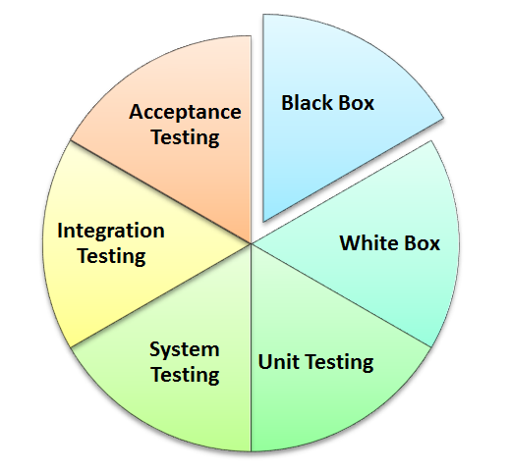
Types of Manual Testing
Notes:
Below given diagram depicts Manual Testing Types. In fact any type of software testing type can be executed both manually as well using an automation tool.

Slide 6

Myths of Manual Testing
Myth: Anyone can do manual testing.
Fact: Testing requires many skill sets.
Myth: Testing ensures 100% defect free product
Fact: Testing attempts to find as many defects as possible. Identifying all possible defects is impossible.

Slide 7
Myths of Manual Testing
Myth: Automated testing is more powerful than manual testing
Fact: 100% test automation cannot be done. Manual Testing is also essential.
Myth: Testing is easy
Fact: Testing can be extremely challenging .Testing an application for possible use cases with minimum test cases requires high analytical skills.

Slide 8
Comparison of Manual and Automated Testing
Automation Testing is use of tools to execute test cases whereas manual testing requires human intervention for test execution.
Automation Testing saves time, cost and manpower. Once recorded, it's easier to run an automated test suite when compared to manual testing which will require skilled labor.

Slide 9
Manual v/s Automated Testing
Any type of application can be tested manually but automated testing is recommended only for stable systems and is mostly used for regression testing. Also, certain testing types like ad-hoc and monkey testing are more suited for manual execution.
Manual testing can be become repetitive and boring. On the contrary, the boring part of executing same test cases time and again, is handled by automation software in automation testing.
Notes:
Ad-hoc Testing: performed without planning and documentation and is an informal activity.
Monkey Testing: where tester test the system by providing random inputs and checking the behavior or seeing whether the system will crash.

Slide 10
Regression Testing
Its another level of testing that is performed throughout the life cycle of a system. It is performed whenever a component of the system is modified.
The key idea in regression testing is to ascertain that the modification has not introduced any new faults in the portion that was not subject to modification.
To be precise, regression testing is not a distinct level of testing. Rather, it is considered as a sub-phase of unit, integration, and system-level testing.

Slide 11
Regression Testing (cont.)
In regression testing, new tests are not designed. Instead, tests are selected, prioritized, and executed from the existing pool of test cases
to ensure that nothing is broken in the new version of the software.
Regression testing is an expensive process and accounts for a predominant portion of testing effort in the industry.
It is desirable to select a subset of the test cases from the existing pool to reduce the cost.

Slide 12
Conclusion
Manual testing is an activity where the tester needs to be very patient, creative & open minded. They need to think and act with an End User perspective.

Slide 13
Test Case Development

Slide 14
Test Case Development
Test Scenario
Test Case Specification
Test Basis
Traceability Matrix

Slide 15
Test Formality
For a newbie, its easy to assume that Testing is executing various section of code ,on a ad-hoc basis and verifying the results.
But in real world, Testing is a very formal activity, and is documented in detail.
The degree of formality depends on the type of application under test , standards followed by your organization ,& maturity of development process.

Slide 16
Test Scenario
A Test Scenario is any functionality of the application under test, that can be tested.
Also called Test Condition or Test Possibility

Slide 17
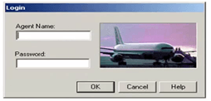
Scenario 1
Check Login Functionality

Slide 18
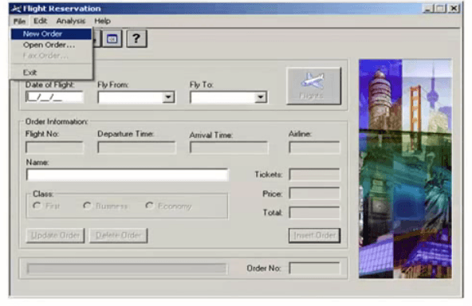
Scenario 2
Check New order

Slide 19
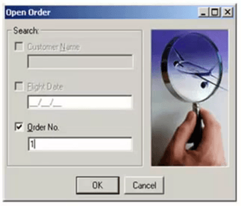
Scenario 3
Check Open Order

Slide 20
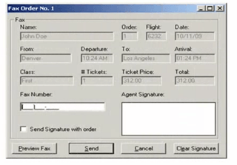
Scenario 4
Check Fax Order

Slide 21
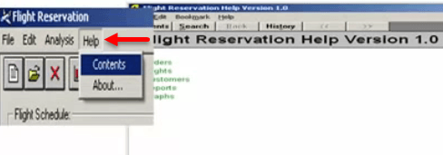
Scenario 5
Check Help Section

Slide 22
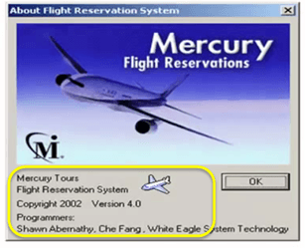
Scenario 6
Check About

Slide 23
Exercise
Check Login
Check New Order
Check Open Order
Check Fax Order
Check Help
Check About

Slide 24
Exercise
Apart from these six scenarios, other possible scenarios for application are:
Update Order
Delete Order
Check Reports
Check Graphs

Slide 25
Exercise
Check Login
Check New Order
Check Open Order
Check Fax Order
Check Help
Check About

Slide 26

Suppose you have time only to execute 4 out of these 6 scenarios which two low priority scenarios of these six will you eliminate. Think, your time starts now
Exhaustive Testing is not Possible

Slide 27
Exercise
Check Login
Check New Order
Check Open Order
Check Fax Order
Check Help
Check About

Slide 28
Test Prioritization
This is nothing but Test Prioritization. Which states, to:
group the test cases according to some criteria (main functionality, specific features, data I/O operations, etc.) and rate the impact (effort to correct) of their failure upon the project. Then, prioritize those with the highest impact.

Slide 29
Test Scenario
Test Cases
Check response on entering valid Agent Name & Password
Check Login Functionality
Check response on entering invalid Agent Name & Password
Check response when Agent Name is empty & Login Button is pressed

Slide 30
Test Case
A Test Case is a set of actions executed to verify a particular feature or functionality of your software application.
Test scenarios are rather vague and cover a wide range of possibilities
Testing is all about being very specific. Hence we need Test Cases

Slide 31
Test Data
Test Scenario | Test Case | Test Data
Check Login Functionality | Check Response on entering valid Agent Name and Password | Agent Name: John Smith Password: Mercury Agent Name: George09 Password: MERcury Agent Name: Liza111 Password: mercury
Identifying test data can be time consuming

Slide 32
Expected Result
Test Scenario | Test Case | Test Data | Expected Result
Check Login Functionality | Check Response on entering valid Agent Name and Password | Agent Name: John Smith Password: Mercury Agent Name: George09 Password: MERcury Agent Name: Liza111 Password: mercury | Login must be Successful

Slide 33
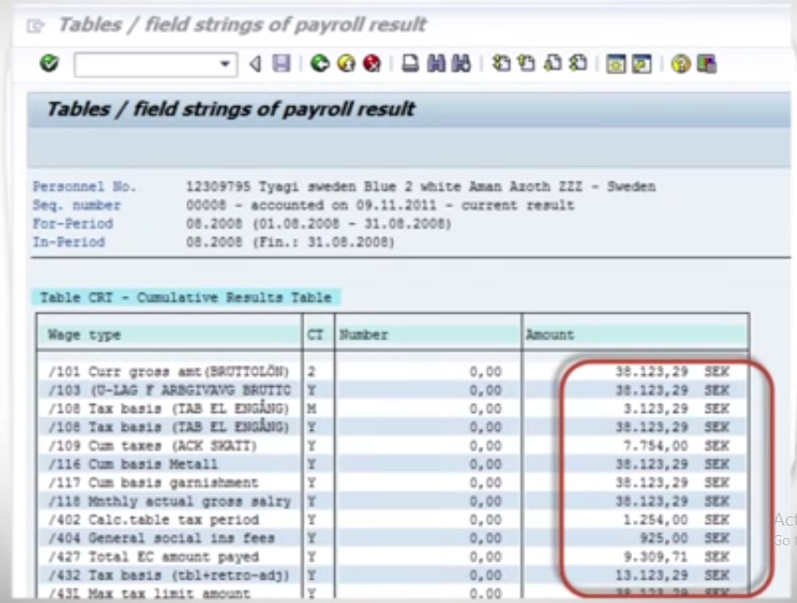
Expected Results
If expected results are not documented then we may miss out on small differences in calculations in results which otherwise look OK.
Notes:
Consider this example, where you are calculating monthly pay for an employee which involves lots of calculations. The need for documenting expected results becomes obvious.

Slide 34

Notes:
Suppose the author of the test case has left the organization or is on a vacation or is sick and off duty or is very busy with other critical tasks and you are recently hired and have been asked to execute the test case.

Slide 35
Test Steps
Taken from an ACTUAL project
Enter transaction Z_OES_CES
Enter variant Z_ETS_GTS
Click Execute
Filter results using variant Z_TE_BE
Test Scenario | Test Case | Test Steps | Test Data | Expected Result
Check Login Functionality | Check Response on entering valid Agent Name and Password | Launch Application Enter Agent Name Enter Password Click OK button | Agent Name: John Smith Password: Mercury Agent Name: JohnSmith09 Password: MERcury Agent Name: 9999 Password: mercury | Login must be Successful
Notes:
You may wonder that for this simple test steps, documentation is not required
But what if your test steps looked something like this ? I think the need will becomes instantaneously obvious.

Slide 36
Pre-Conditions & Post Conditions
Test Scenario | Test Case | Pre-Conditions | Test Steps | Test Data | Expected Result
Check Login Functionality | Check Response on entering valid Agent Name and Password | Flight Reservation Application must be installed | Launch Application Enter Agent Name Enter Password Click OK button | Agent Name: John Smith Password: Mercury Agent Name: JohnSmith09 Password: MERcury Agent Name: 9999 Password: mercury | Login must be Successful
Post-Condition:Anything that applies after the test case completes
e.g.: Time, Date of login is stored in Database
Notes:
That apart your test case -may have field like , Pre - Condition which specifies things that must in place before the test can run
For our test case , a pre-condition would be Flight Reservation Application should be installed.
Also, your test case may also include Post - Conditions which specifies anything that applies after the test case completes.
For our test case , a post - condition would be time & date of login is stored in the database

Slide 37
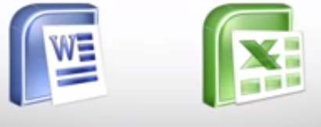
Test Scenario | Test Case | Pre-Conditions | Test Steps | Test Data | Expected Result | Actual Result | Pass/ Fail
Check Login Functionality | Check Response on entering valid Agent Name and Password | Flight Reservation Application must be installed | 1.Launch Application 2.Enter Agent Name 3.Enter Password 4.Click OK button | Agent Name: John Smith Password: Mercury Agent Name: JohnSmith09 Password: MERcury Agent Name: 9999 Password: mercury | Login must be Successful | Login Successful | Pass
Notes:
During test case execution , you will document the results observed in the Actual Results column and may even attach some screen shots and based on the results give PASS & FAIL status.
This entire table may be created in Word , Excel or any other Test management tool. That's all to Test Case Design

Slide 38
Testing Techniques
Practically, due to time and budget considerations, it is not possible to perform exhausting testing for each set of test data,
Especially when there is a large pool test cases. We need an easy way or special techniques that can select test cases intelligent from the pool of test-case, such that all test scenarios are covered.

Slide 39
Testing Techniques
Equivalence Partitioning
Boundary Value Analysis
Decision Table Testing
State Transition Testing
Use Case Testing
Static Testing

Slide 40
Equivalence Partitioning
It is a black box technique (code is not visible to tester) which can be applied to all levels of testing like unit, integration, system etc.
In this technique, you divide set of test condition into partition that can be considered the same.

Slide 41
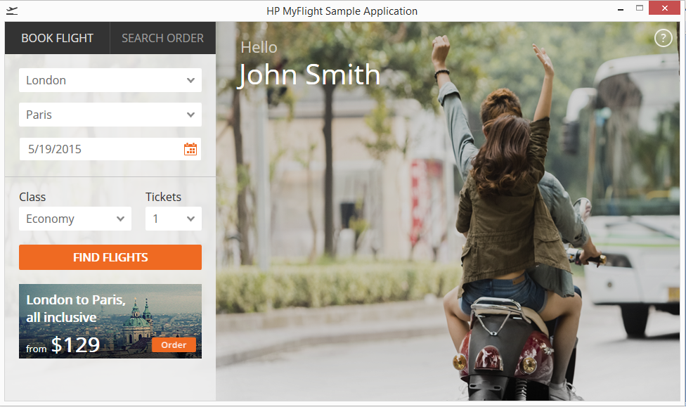
Behavior of No. of Tickets Field
How System Decides, how many reservation users should be allowed
“Only ten tickets may be ordered at one time”

Slide 42
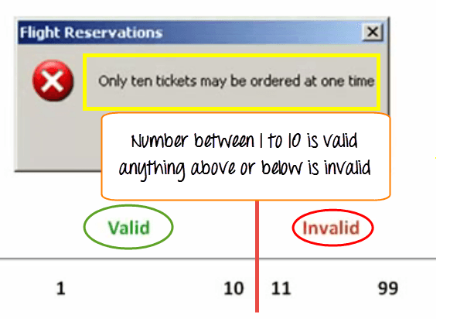

Slide 43
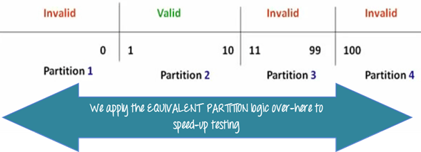
Here is the test condition
Any Number greater than 10 entered in the reservation column (let say 11) is considered invalid.
Any Number less than 1 that is 0 or below, then it is considered invalid.
Numbers 1 to 10 are considered valid
Any 3 Digit Number say -100 is invalid.
The divided sets are called Equivalence Partitions or Equivalence Classes.
Notes:
The divided sets are called Equivalence Partitions or Equivalence Classes.

Slide 44
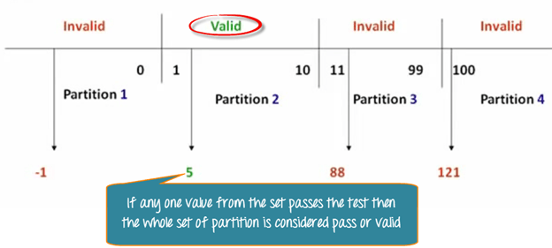
Equivalence Partitioning
We cannot test all the possible values because if done, number of test cases will be more than 100.
we divide the possible values of tickets into groups or sets where the system behavior can be considered the same.
Then we pick only one value from each partition for testing.
The hypothesis behind this technique is that :
if one condition/value in a partition passes all others will also pass. Likewise, if one condition in a partition fails, all other conditions in that partition will fail.

Slide 45
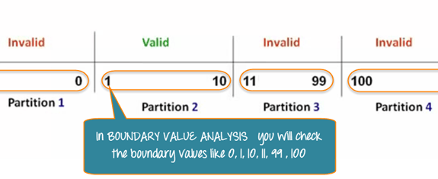
Boundary Value Analysis
It is also a black box technique. in Boundary Value Analysis, you test boundaries between equivalence partitions
In our earlier example instead of checking, one value for each partition you will check the values at the partitions like 0, 1, 10, 11 and so on. As you may observe, you test values at both valid and invalid boundaries.
Boundary value analysis is also called range checking.

Slide 46
Equivalence partitioning and boundary value analysis are closely related and can be used together at all levels of testing.

